Slide 1

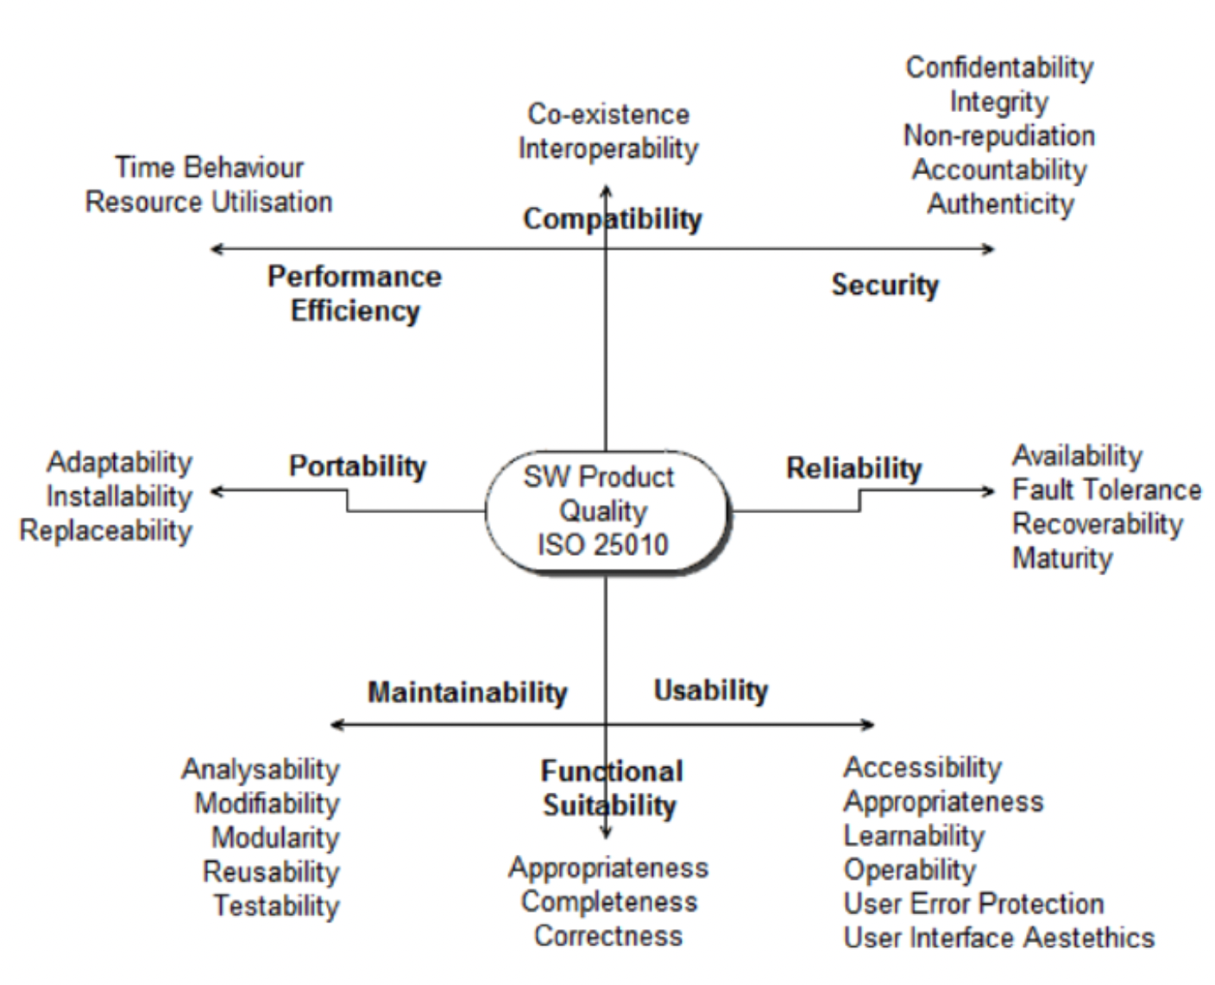
Software Engineering Processes (SOEN 6011)
Manimaran Palani
Iphigenia Pappas
Heet Patel
Kevinkumar Patel
Venis Patel
Candidate R
Project Objective
Critical Decisions Made
Metrics used to Review
Refactoring Results
Software ISO/IEC 25010: Software Quality Standard
Retrospective/Improvements in R
References
1.https://www.researchgate.net/figure/Software-product-quality-according-to-ISO-IEC-25010_fig2_263765466
Software Engineering Processes
Professor: Dr. Pankaj Kamthan
Project Description

